Slide 1
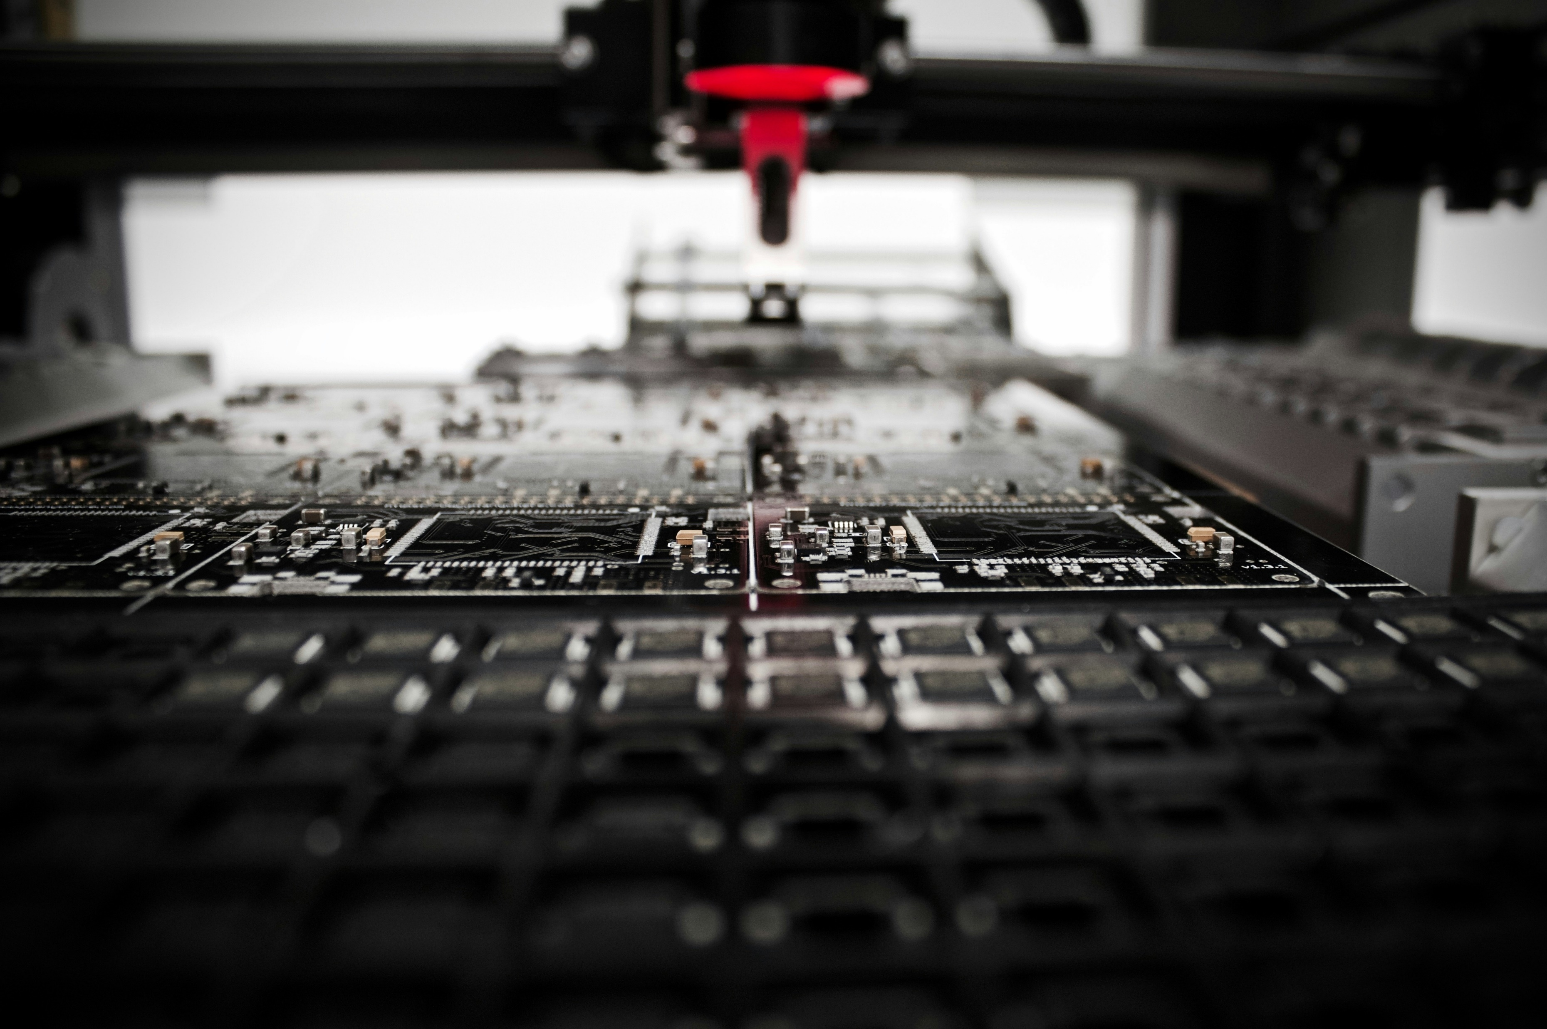
COMPANY B
MANUFACTURING
Notes:
good evening. we are company B group B, manufacturing line.

Slide 2
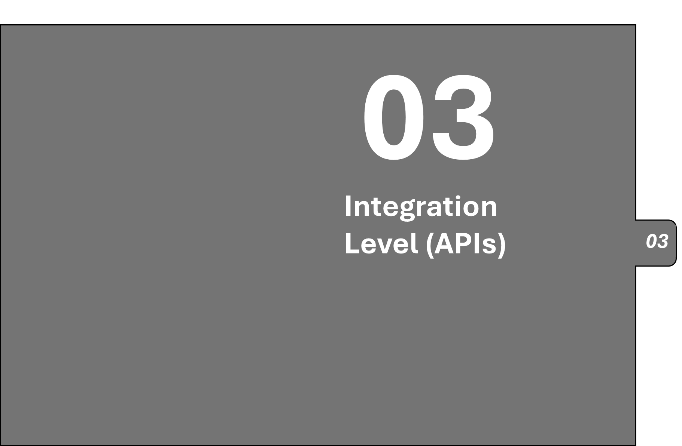
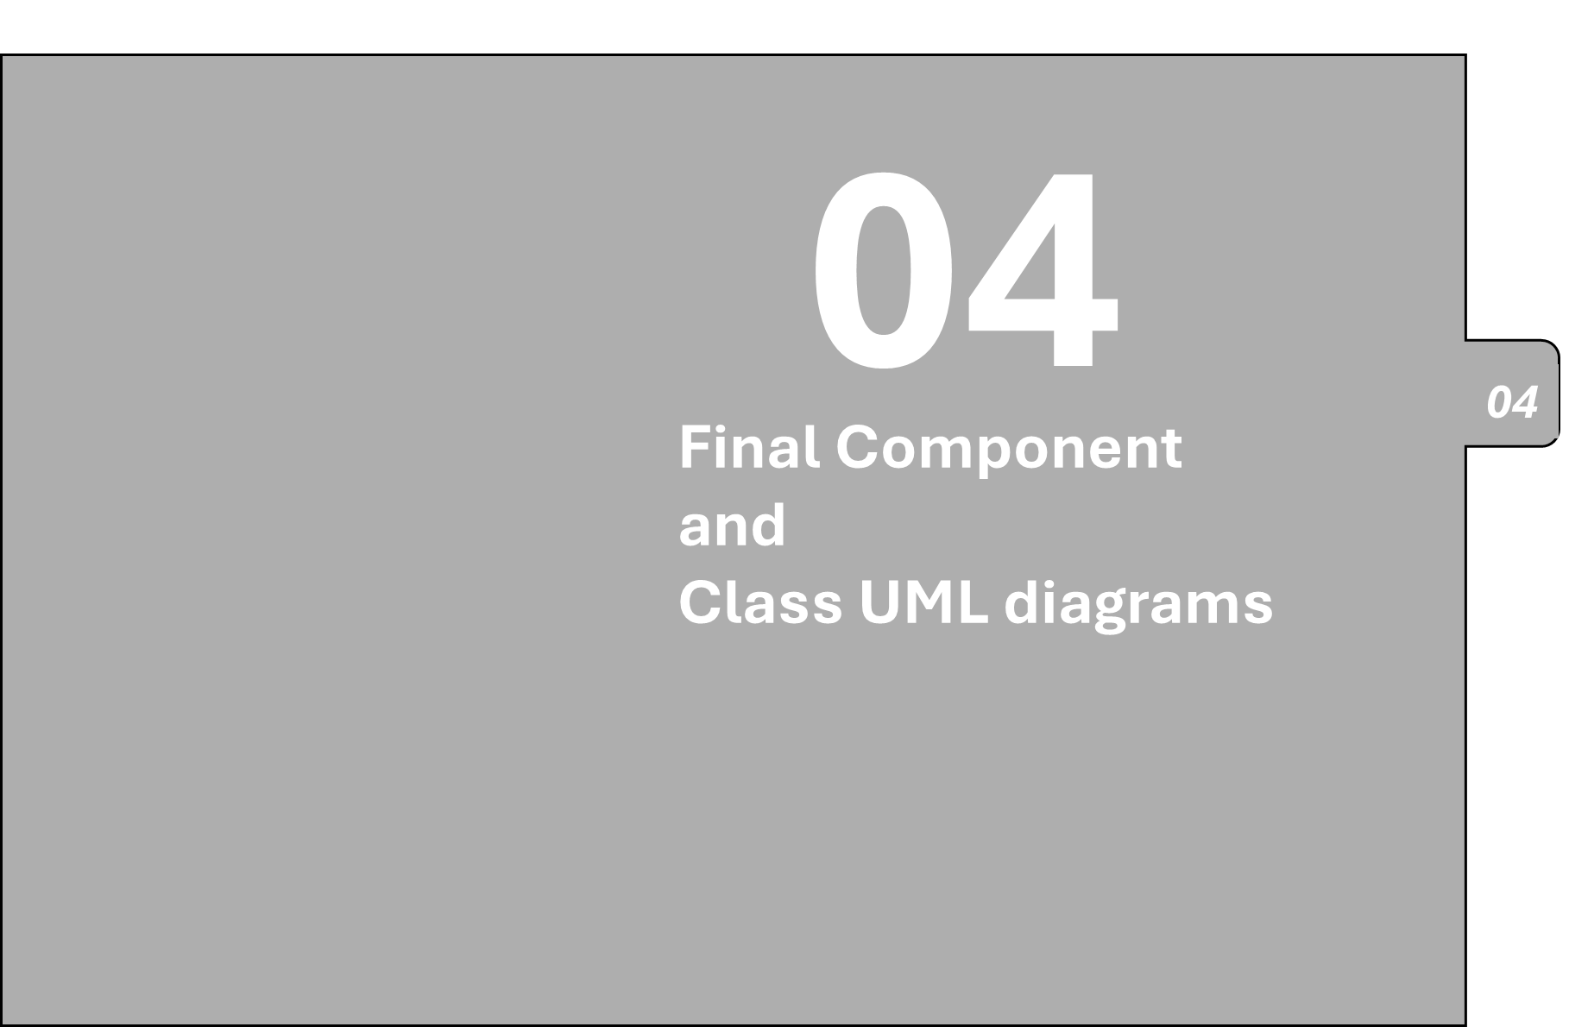
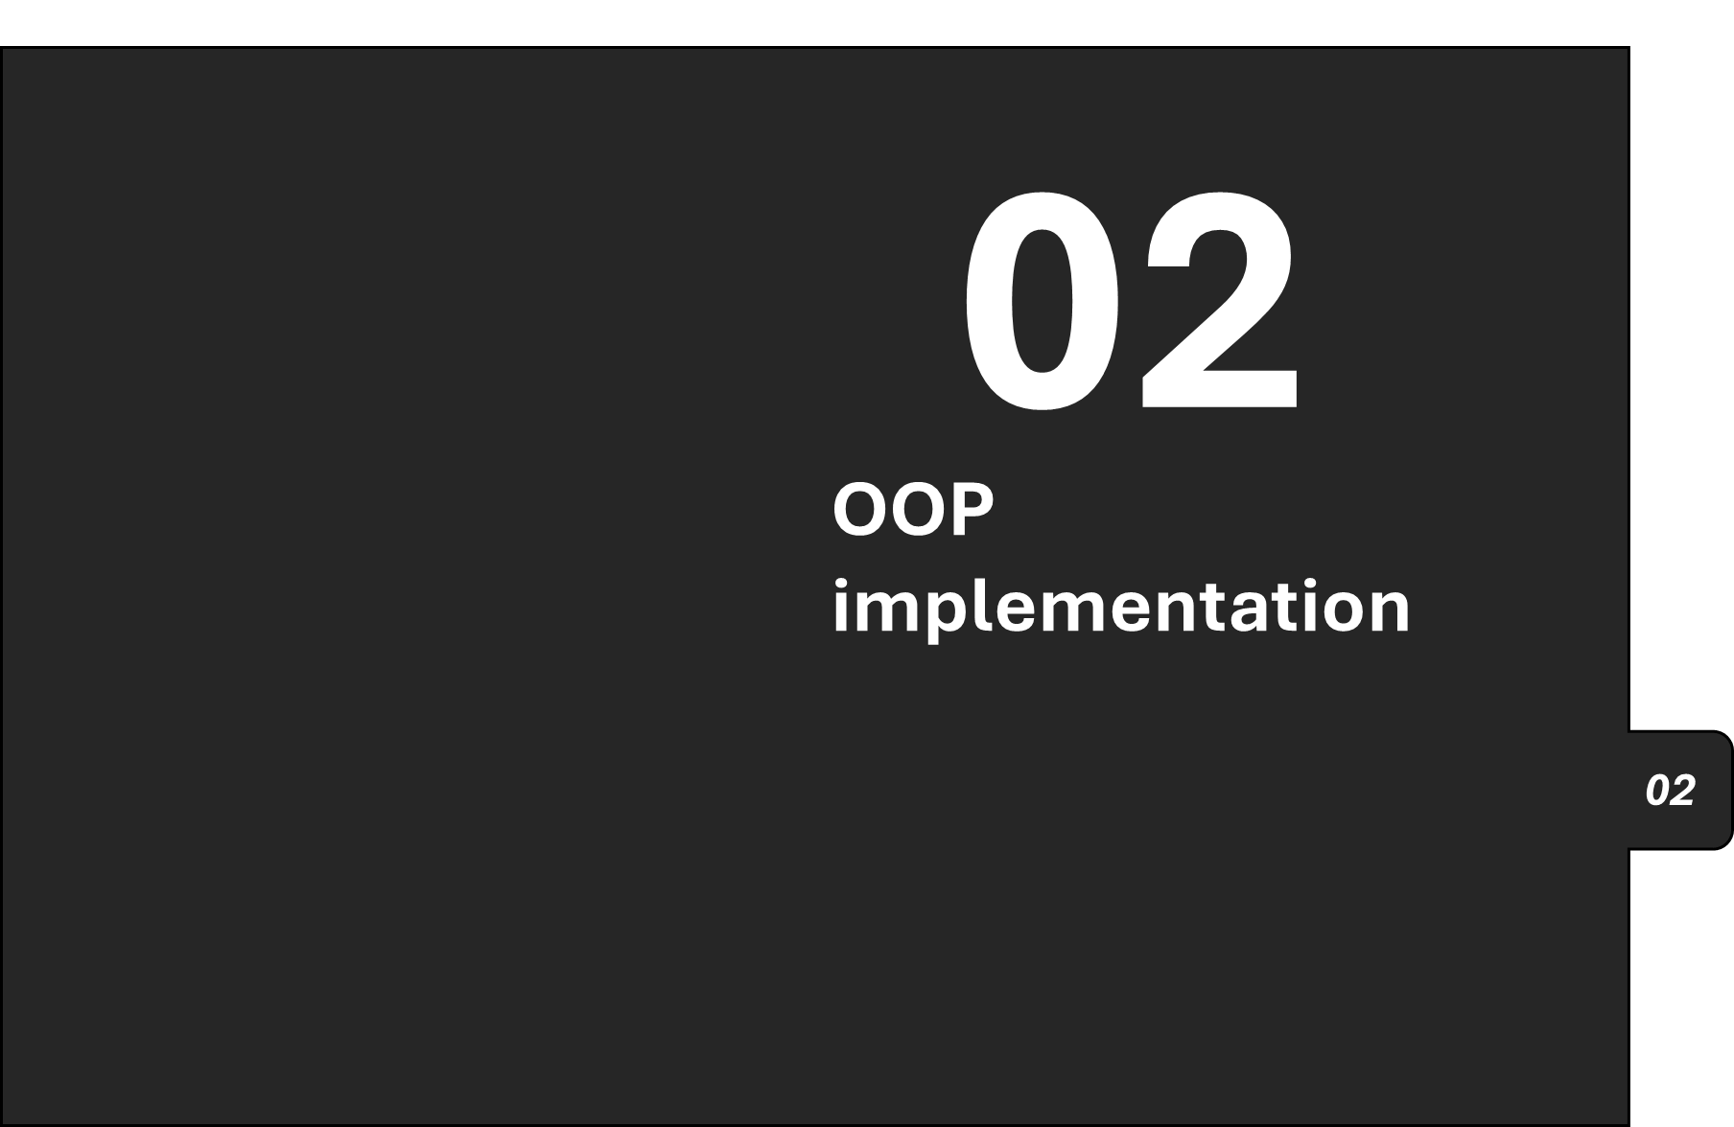
01
chapter
slides
Demonstration of user stories/scenarios
01

Slide 3

01
Demonstration of user stories/scenarios
01
Notes:
Since the first group has already described how we implemented the database, the tools we used, and how we initialized the repositories, I would like to move the demonstration of user stories and scenarios for the manufacturing application due to time constraints.

Slide 4

01Demonstration of user stories/scenarios
WORKER LOGIN
ADD NEW ORDER
ADMIN INTERFACE
WORKSTATION 2 AND PASS THE ORDER TO NEXT STATION
WORKSTATION 3 AND COMPLETE ORDER
Notes:
this section showcases the implementation of various user flows and functionalities withing the application. mainly there is 5 user scenarios.
1
2
3
4
5

Slide 5
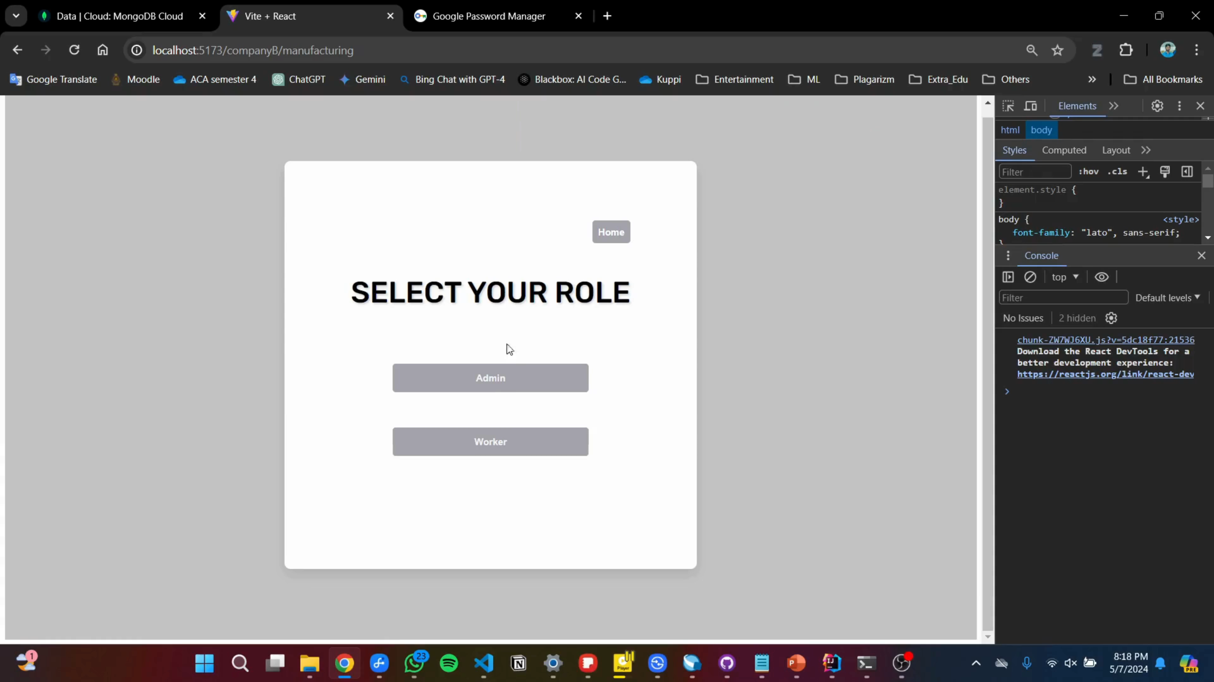
WORKER LOGIN
Notes:
first one is worker login.

Slide 6

ADD NEW ORDER

Slide 7
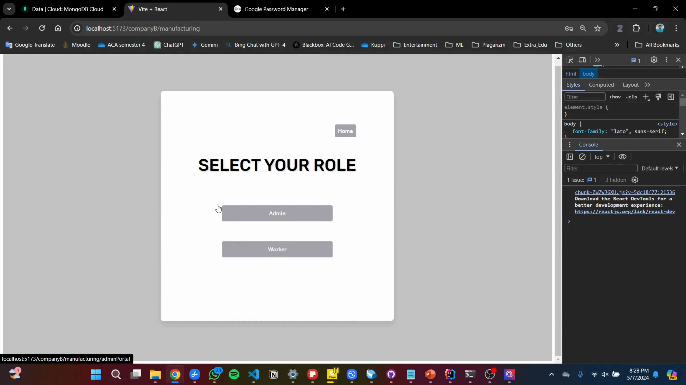
ADMIN INTERFACE

Slide 8
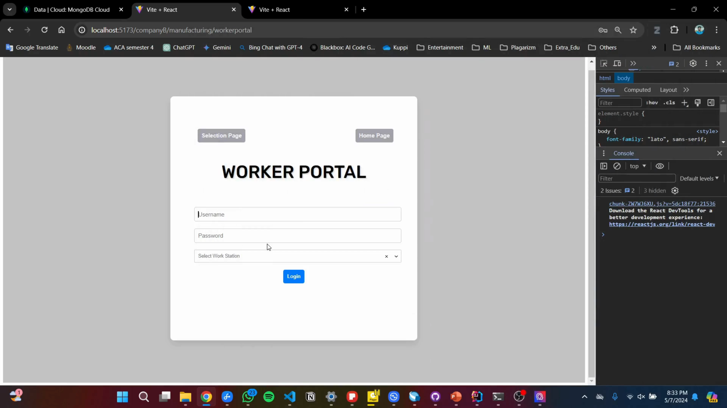
WORKSTATION 02 AND PASS THE ORDER TO NEXT STATION

Slide 9
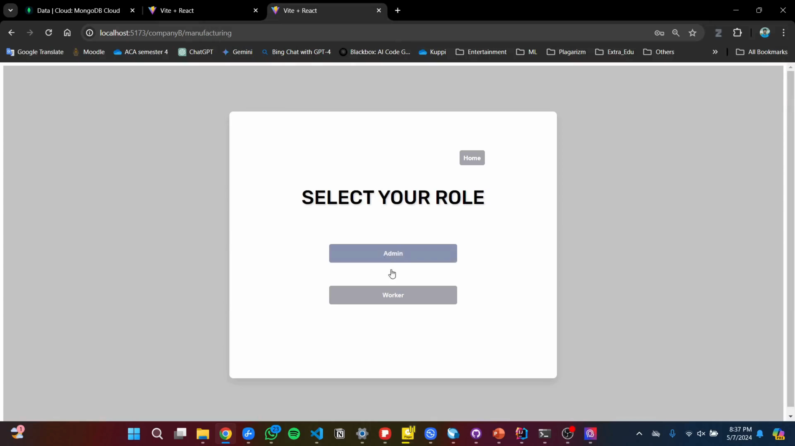
WORKSTATION 03 AND COMPLETE ORDER

Slide 10
01
Demonstration of user stories/scenarios
01

Slide 11

01
Demonstration of user stories/scenarios
01

Slide 12

02 OOP implementation
Encapsulation
Inheritance
Abstraction
Polymorphism

Slide 13

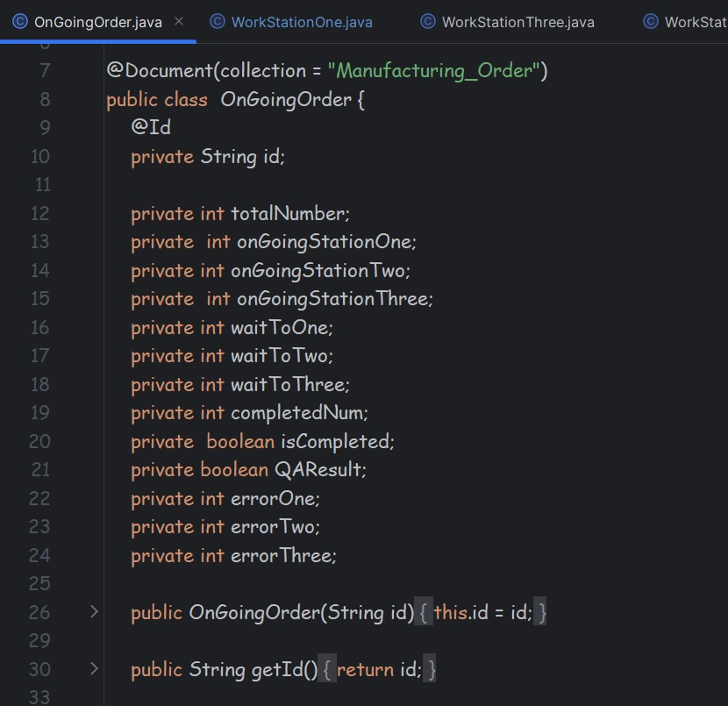
Encapsulation
Ongoing order:-
All the attributes are private. So, they can’t be accessed outside the class.
Workstation:-
In workstations, we have instantiated ongoing order objects. So, we can edit attributes of relevant objects. So, this will prevent accidental mistakes which can be done by a programmer.

Slide 14
Inheritance
Workstation
Workstation one
Workstation two
Workstation three

Slide 15
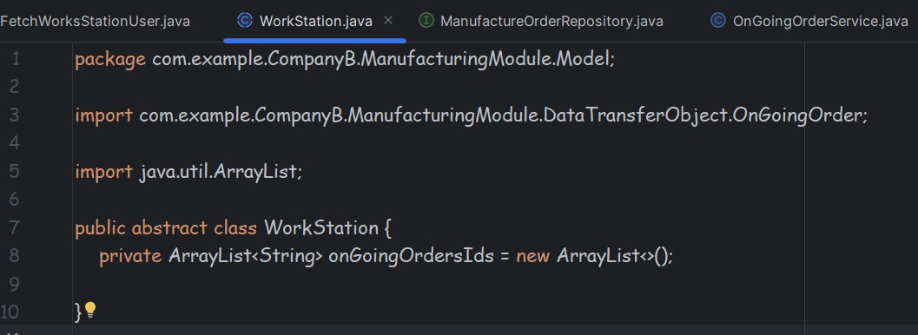
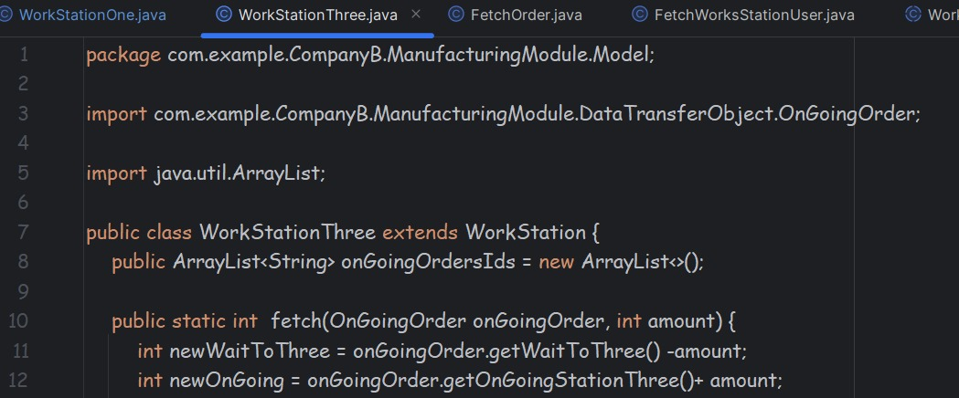

Slide 16
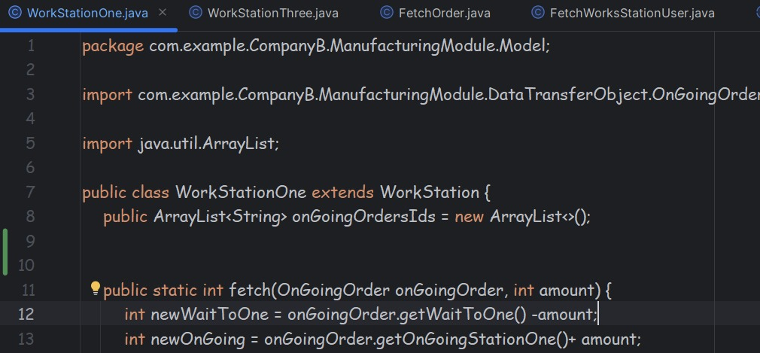
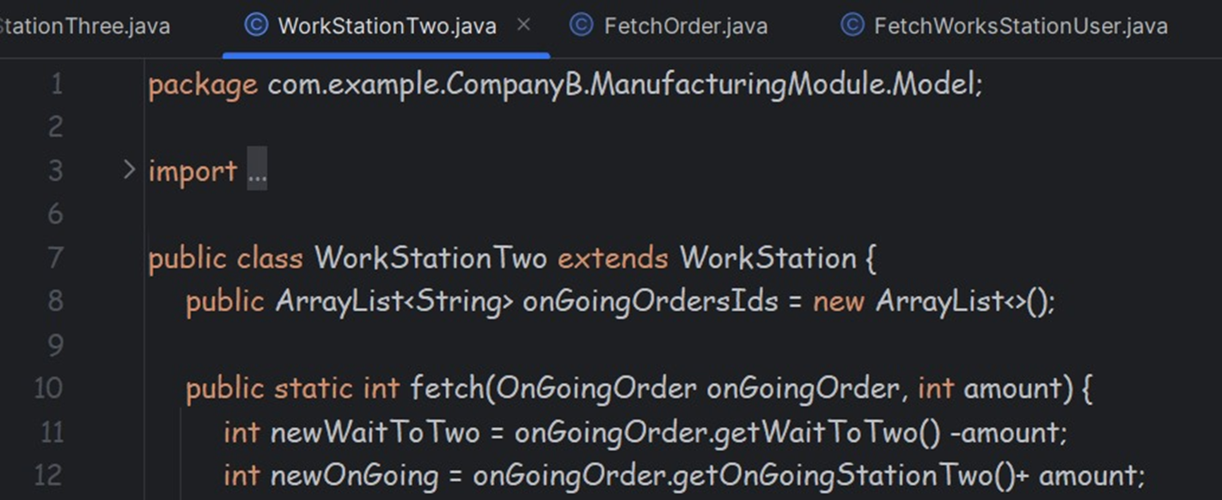

Slide 17

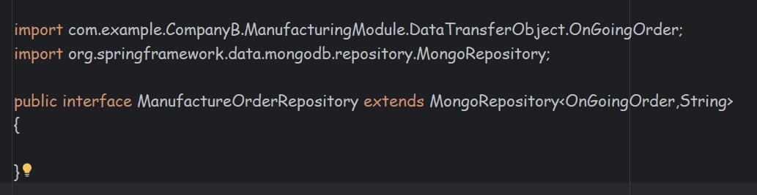
Abstraction
We have created interface for data base access because we can't implement concreate methods with data base.

Slide 18

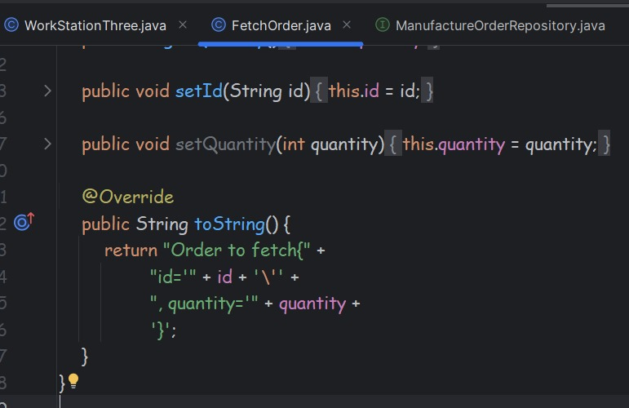
Polymorphism
For testing purposes, we need to get database values to output consoles.
For that we have overwrite tostring() function of each data transfer model

Slide 19
01
Demonstration of user stories/scenarios
01

Slide 20
01
Demonstration of user stories/scenarios
01

Slide 21
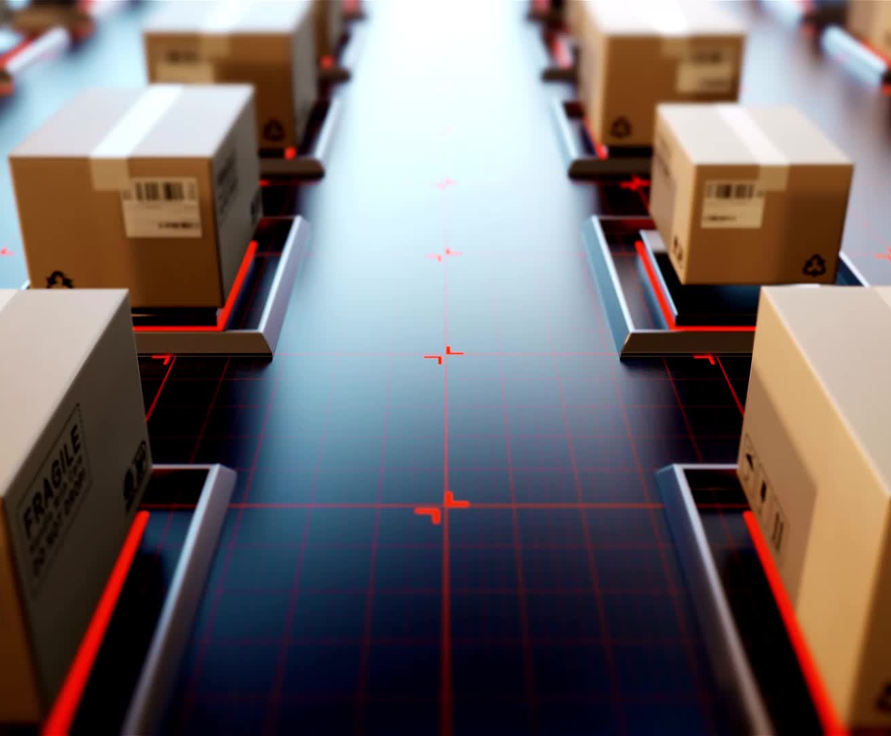
03 Integration Level (APIs)
Endpoint URLs
Request Methods
Handling Responses
Error Handling

Slide 22
Endpoint URLs
• Endpoint for admin login authentication..
http://localhost:8090/companyB/manufacturing/User/adminLogin/${details. username}/${details.password}
• Endpoint for workstation login authentication
http://localhost:8090/companyB/manufacturing/User/adminLogin/${details. username}/${details.password}
• Endpoint for fetching orders
http://localhost:8090/companyB/manufacturing/FetchOrders/{orderId}
• Endpoint for adding orders to Workstations
http://localhost: 8090/companyB/manufacturing/OnGoingOrder/WorkstationOneFetch/{orderId}
• Endpoint for worker sign-out action.
http://localhost:8090/companyB/manufacturing/User/workStation/signout/1
• Endpoint for passing items to the next station from Workstations.
http://localhost:8090/OnGoingOrder/WorkstationOnePass/{orderId}
• Add error item.
http://localhost:8090/companyB/manufacturing/OnGoingOrder/ WorkstationOneError/’+orderId1+’/’(1)

Slide 23

Request Methods
• PUT requests are used for actions like updating order status or passing items to the next station.
• POST requests are used for actions like adding new orders or logging in users

Slide 24

Handling Responses
• If a login request is successful, the user is redirected to the admin interface or worker interface page. This will done using the response body. If the response body equals ”login successful”, the front end will push the relevant interface point.
• If an error occurs during the request, the response will contain the error. This error will displayed in the front end using alerts.
.
.
Notes:
This describes how the application handles responses from the api. Successful login requests redirect the user to the appropriate interface. Errror responses are displayed as alerts to the user. The response body is used to determine the next action on the frontend.

Slide 25

Error Handling
The frontend application includes error handling mechanisms to deal with cases where API requests fail or return errors.
Error messages are displayed to provide feedback to the user about any issues encountered during the interaction with the server.
Notes:
This focuses on the error handling mechanism in the frontend application. It mentions that the frontend includes error handling to deal with failed api requests or errors returned by the server. Error masseges are displayed to provide feedback to the user about any issues encountered during the interaction with the system.

Slide 26
01
Demonstration of user stories/scenarios
01

Slide 27
01
Demonstration of user stories/scenarios
01

Slide 28
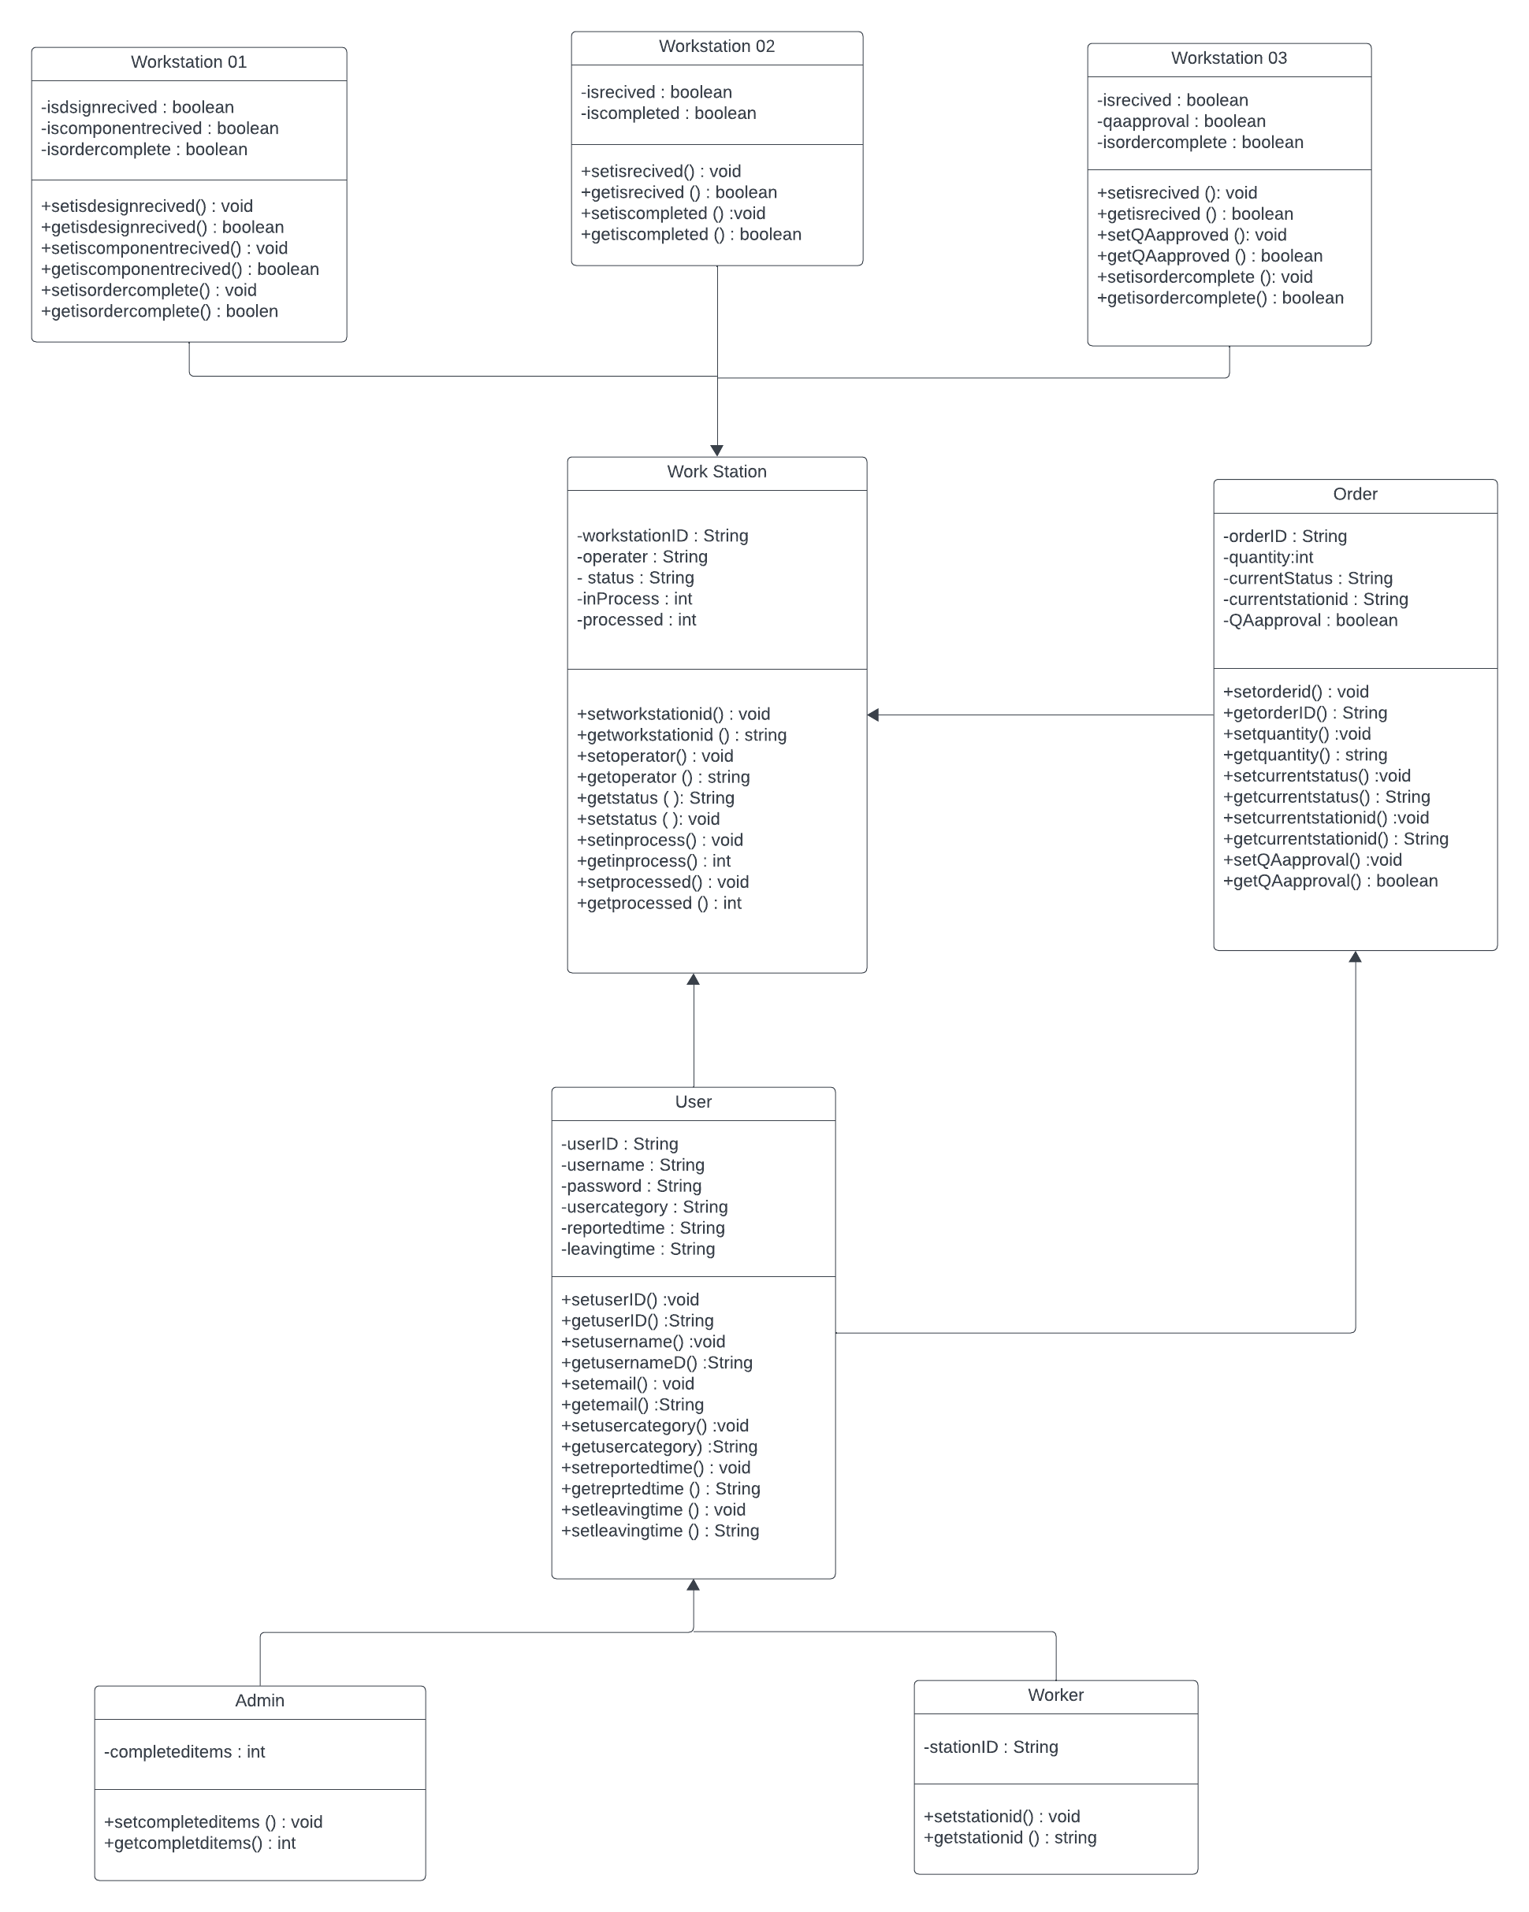
Final Component and Class
UML
diagrams

Slide 29
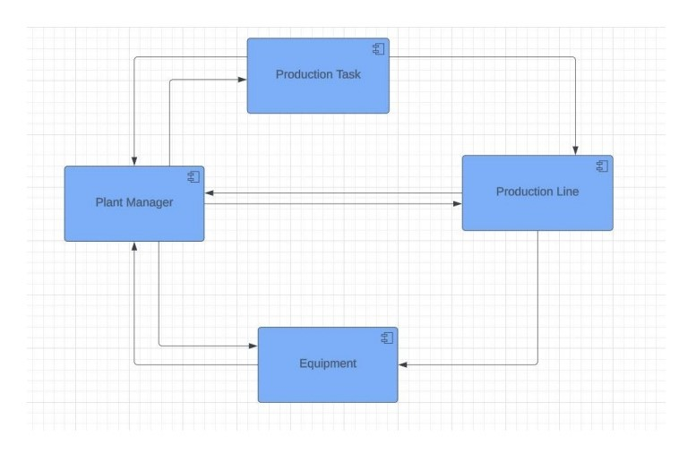
Component diagram

Slide 30

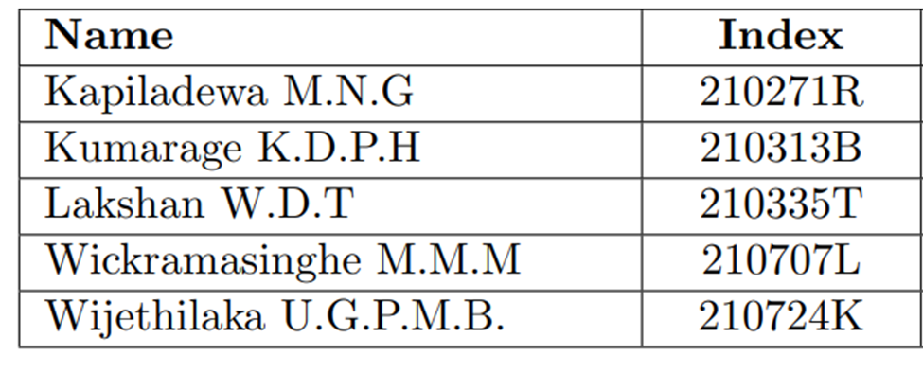
Thank you

